Slide 1

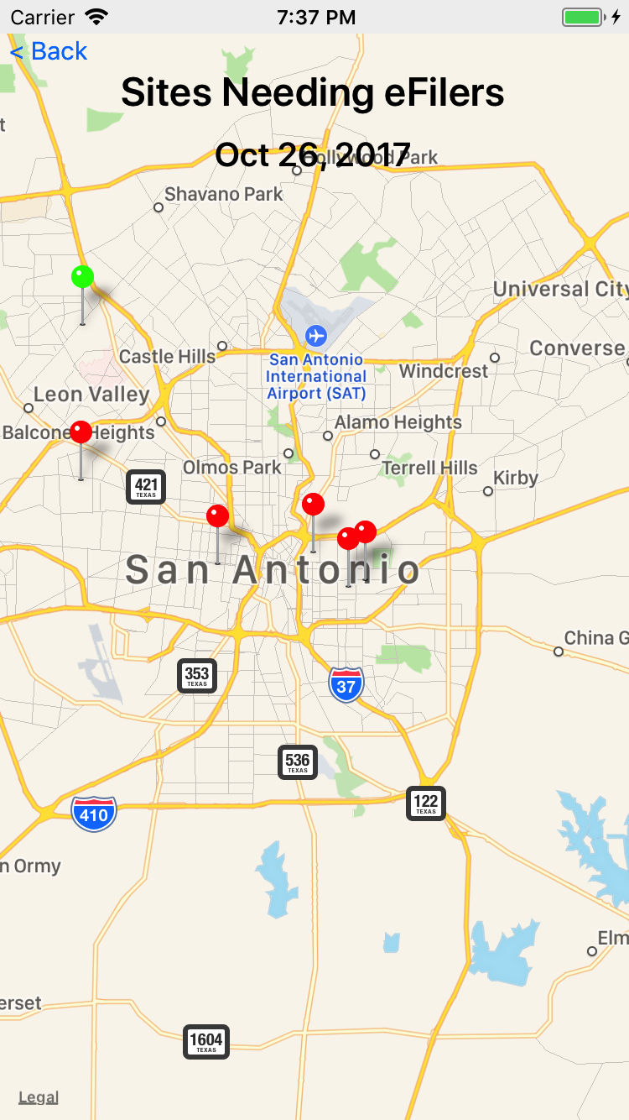
VITA SA App
Volunteer Management
For iPhone and Android phones
Encourage volunteers to go to the sites that need help.
(and away from sites that don’t)
Optimize the customer experience by fully utilizing staff, sites, and volunteers.

